Slide 1

MPI / PIANZ / EPF Webinar
HPAI Study Tour Findings
Industry Webinar
24 September 2024

Slide 2
HPAI Study Tour Operational Summary: Key Takeouts
Key Takeouts from the Study Tours:
Very successful tours with high level of engagement and access to key decision makers, government officials, industry bodies and site visits
HPAI H5N1 2.3.4.4b – wildlife adapted strain is different to AU HPAI and requires different planning
Outbreaks are associated with the seasonal migratory patterns of wild birds
Strong farm and shed biosecurity is key
HPAI is NOT a food safety issue. There was no drop in poultry meat and egg consumption by consumers during any of the incursions. Early messaging from the relevant authorities was key to managing the situation
MPI working with Industry will deliver better outcomes for the country
Investing in preparedness now will increase our ability to withstand an incursion
Whilst we have identified work to do, we are on the right track

Slide 3
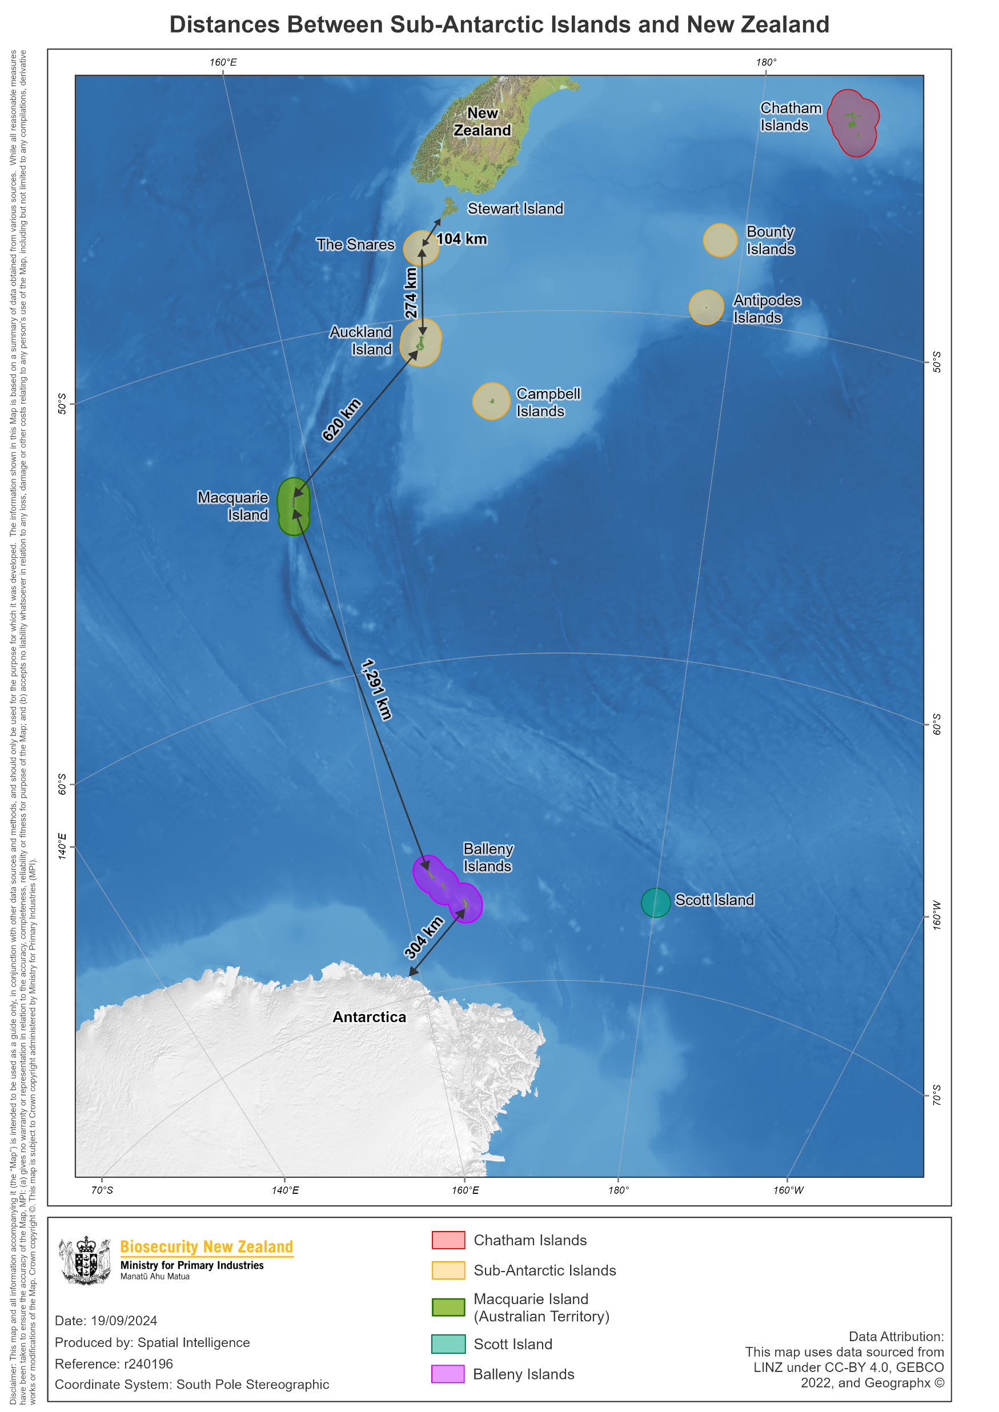
New Zealand – current state and risk level
New Zealand has never had a case of highly pathogenic avian influenza (HPAI)
At our previous webinar we discussed how a particular strain of HPAI has spread around the world affecting wildlife and poultry and has spilled over into mammals
This strain has been found in the Antarctic peninsula
The recent outbreaks in Australia are not associated with this strain, and so the findings in Australia do not change the risk to New Zealand
Scientists have reported that the spread of HPAI is much more likely to occur when infections are detected less than 1000km away. It seems to be an uncommon event for a bird infected with H5N1 to travel 1000km or more and infect a new place
Notes:
For example, recent analysis shows South Georgia wildlife were infected by a single bird from (probably) Argentina which is around 2000km away. Similarly, since the Galapagos Islands outbreak has resolved, there have been no more reported incursions from the South American mainland which is 1000km away.
Sub-Antarctic islands south of New Zealand are around 1,500–2,000 km from the Antarctic mainland, and the longest distance between islands are about 1,291 km (see map on overleaf). The Chatham Islands are around 6,000 km from the Antarctic Peninsula. Map one shows the distances birds infected with HPAI would have to travel if it were to arrive in New Zealand from Antarctica.

Slide 4
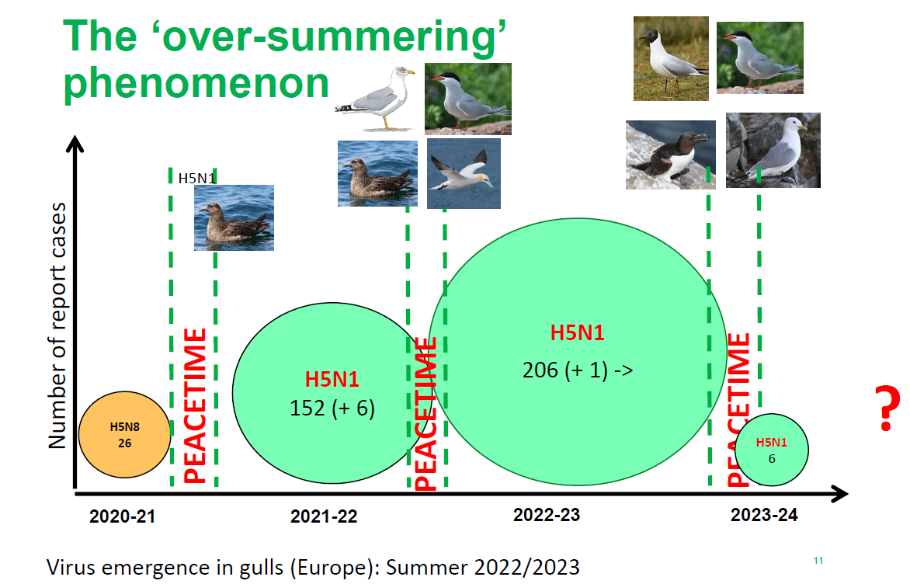
HPAI Study Tour Operational Summary: Why go to UK?

Slide 5
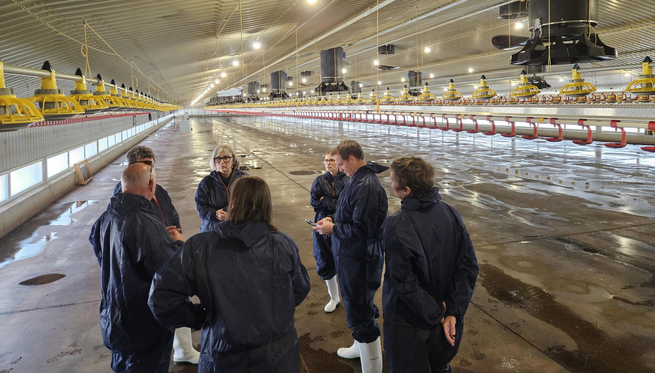
HPAI Study Tour Operational Summary: Key takeouts of what was important in the UK – Readiness
Investing in preparedness now is key
  crisis management
  business continuity plans
Strong and aligned relationships between regulators, industry bodies and farmers
Joint plans in place
Strong on-farm biosecurity is the single most significant activity to decrease the risk of infection at farm level
Sector-specific business continuity plans needed down to the enterprise level
UK uses a tiered system to manage ‘biosecurity fatigue’
Strong existing contractor relationships (e.g. Livetec Ltd.)
Consider impacts on mental health in rural communities, farmers and all parties involved in the response

Slide 6
HPAI Study Tour Operational Summary: Key takeouts of what was important in the UK – Response
Movement control/zoning at various levels:
  outer perimeters and inner perimeters around the shed; 3km zones aligned to EU legislative requirements
Depopulation – a suite of tools available depending on enterprise type
  Containerized gassing units (CGUs); foaming
Disposal – a suite of tools depending on material and enterprise type. Including rendering of birds (extensive rendering industry in place). Litter, eggs, feed, packaging, wastewater, and PPE all require disposal
Cleaning and disinfection – industry and farmers are best placed to deliver the activities and present plans for approval by the regulator, e.g. including cleaning protocols for control rooms, equipment, farm packers/graders
Sentinel birds were used as part of the return to production
PPE standards/guidance – pragmatism the key to adoption
Housing orders – applied based on wild bird prevalence (used over-stickering on products)
Testing at an official government laboratory
Act with movement controls on suspicion of a case (before laboratory confirmation) until testing and tracing are completed.
Understanding of what was allowable and what options were available was variable across the industry

Slide 7
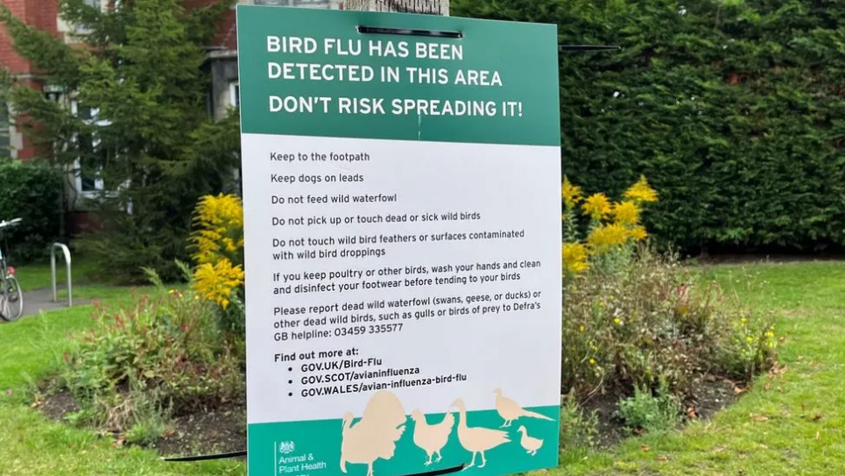
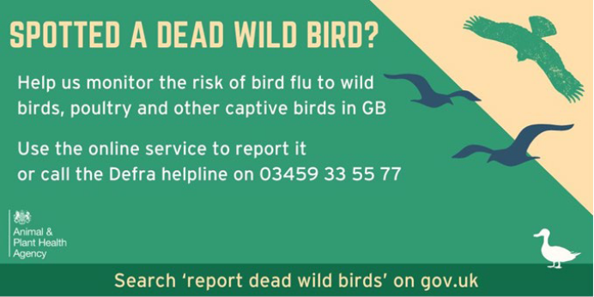
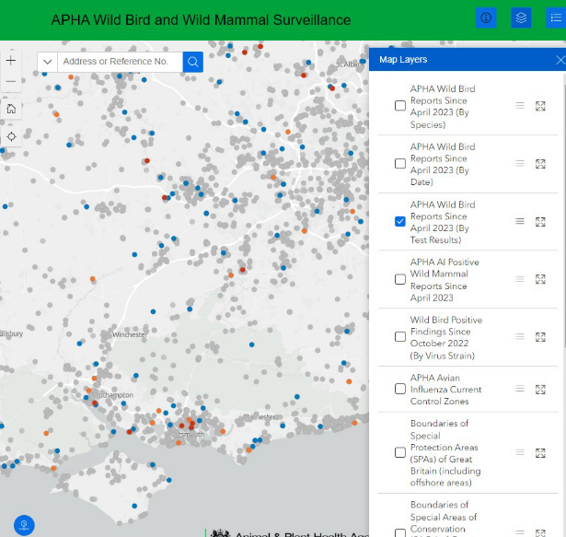
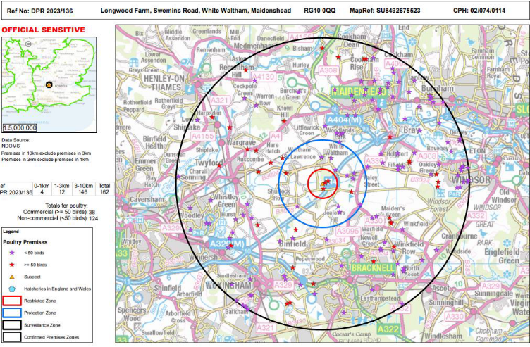
HPAI Response: Aligned Communication is Key, MPI & Industry Together
  Communicate early. Get information out in the public domain and desensitise the issue. Not a food safety issue
  One source of truth, avoid conspiracies
  Interactive map key to managing multiple stakeholders – public, media, industry, trade
  Fast and consistent messaging to the front lines is critical for consistency
  Clarity of front-line decision-making authority is required up front (e.g. vets, case managers)
  Images are key. e.g. live birds vs food shots

Slide 8
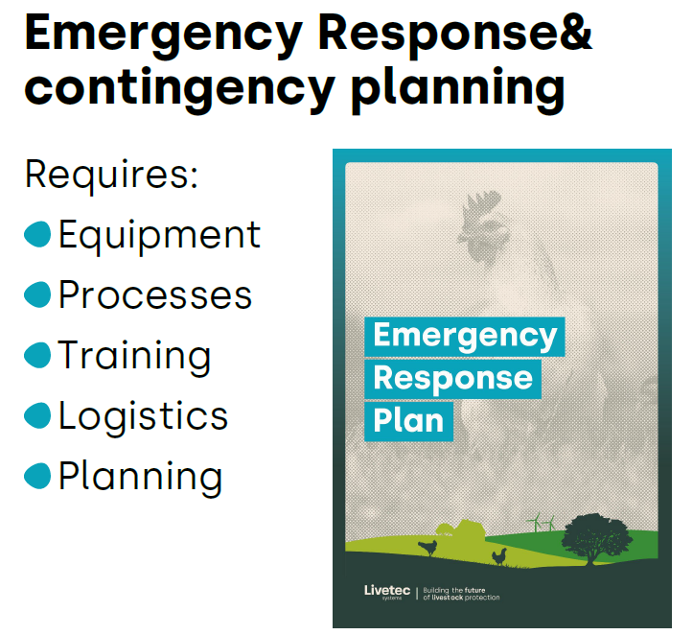
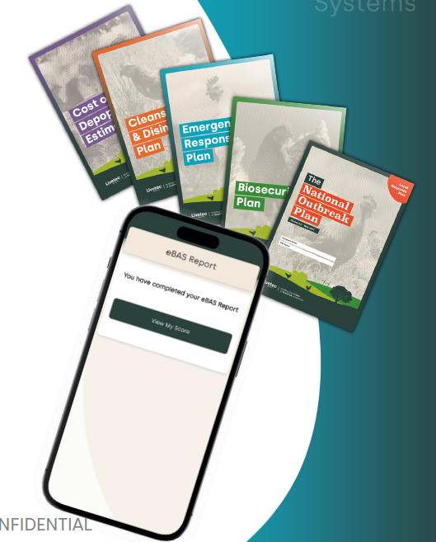
HPAI Response: Contingency Plans
Need documented contingency plans
Industry
Company
Farm
Importance of singular responsibility for biosecurity

Slide 9
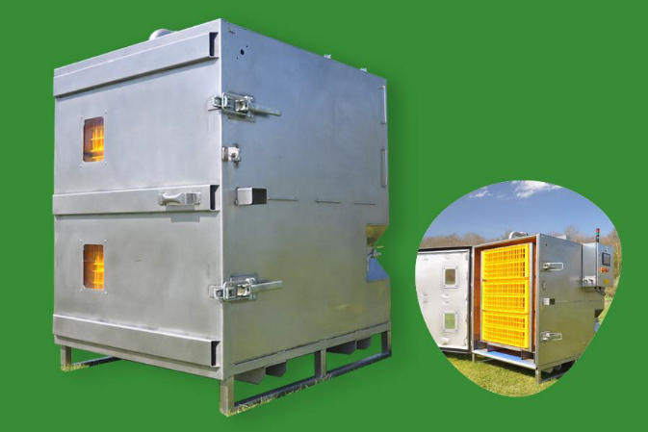
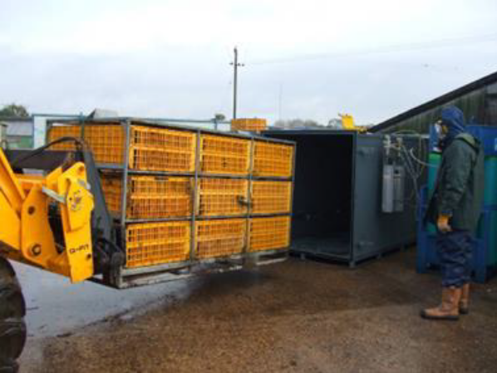
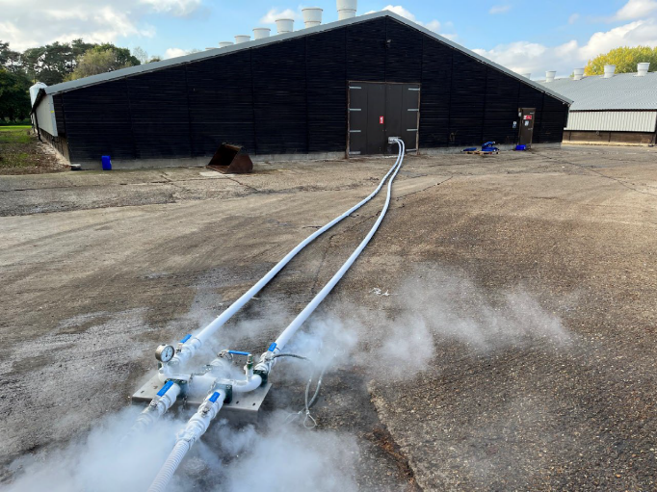
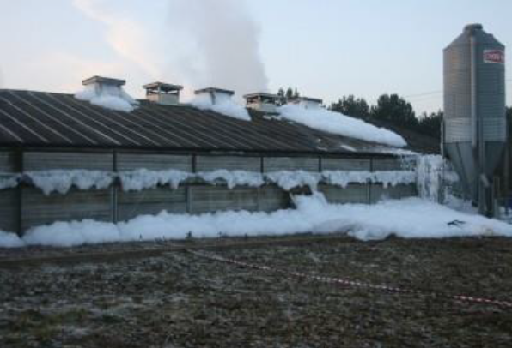
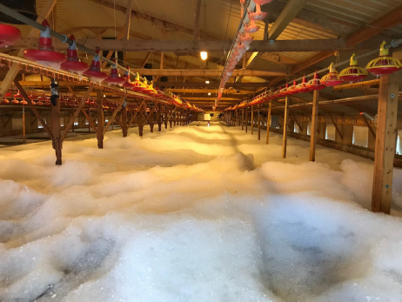
HPAI Response: Depopulation
A number of options used in UK
CGUs (Containerised Gassing Units)
Whole House Gassing
Nitrogen Foam

Slide 10
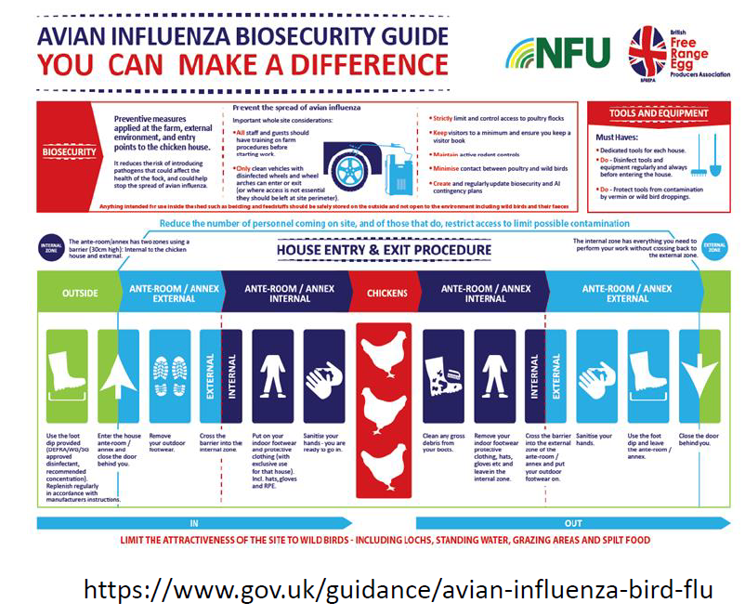
On-farm Biosecurity: Control What We Can Control

Slide 11
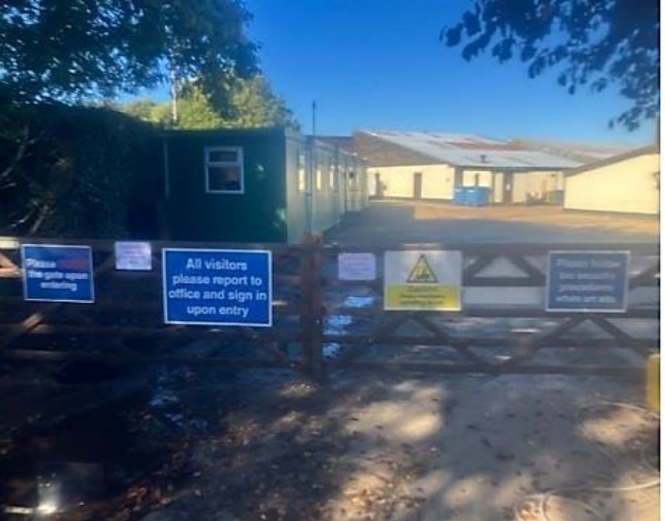
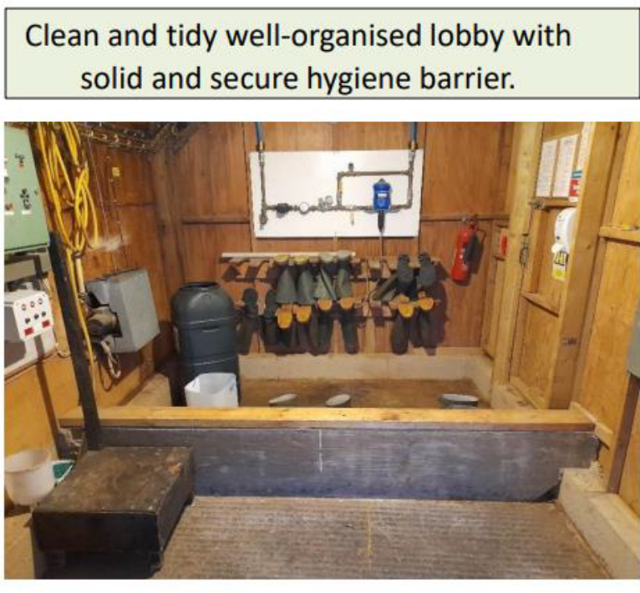
On-farm Biosecurity: Getting the mindset right
Farm outer layer, shed is hard inner layer
Protection of the birds in the sheds is key – the shed is a high care zone, only essential staff can enter
Need a cultural mindset that “HPAI could be anywhere outside the shed, need to ensure you are not the person to bring it into the shed”
“It only takes one lapse the get an incursion”

Slide 12
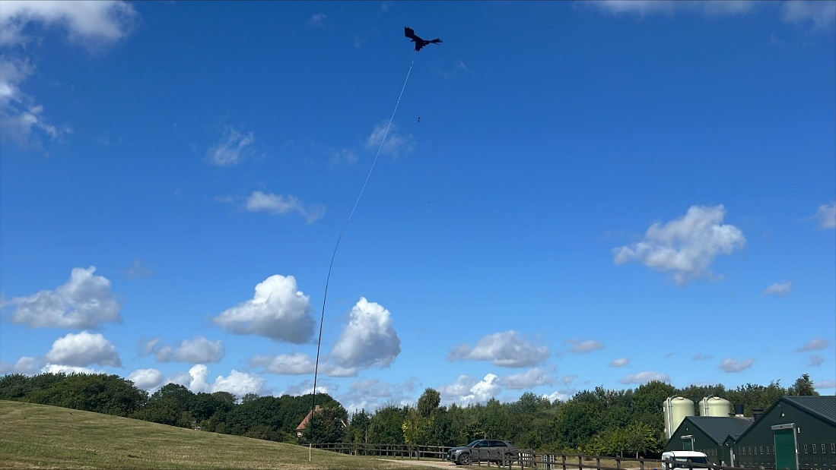
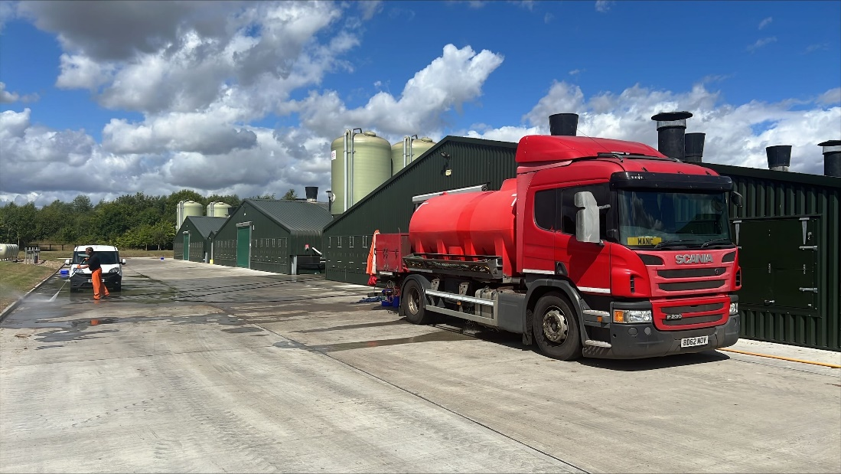
On-farm Biosecurity: Reduce wild bird risk
The majority of Infected Properties (IPs) are due to direct or indirect introduction from wild birds
Bird proofing of sheds
Clean feed spills
No standing water
Net small ponds
Bird scarers & lasers
Cleaning areas outside of sheds every 2 days
Well kept premises (not using mowing equipment across multiple properties)
2 Key Vectors:
Water ingress – flooding, leaking sheds
Ducks are a dangerous vector

Slide 13
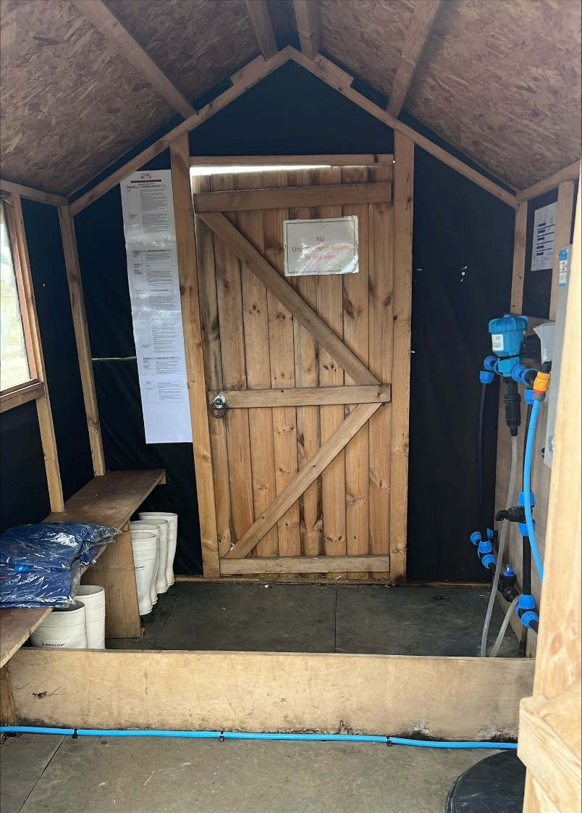
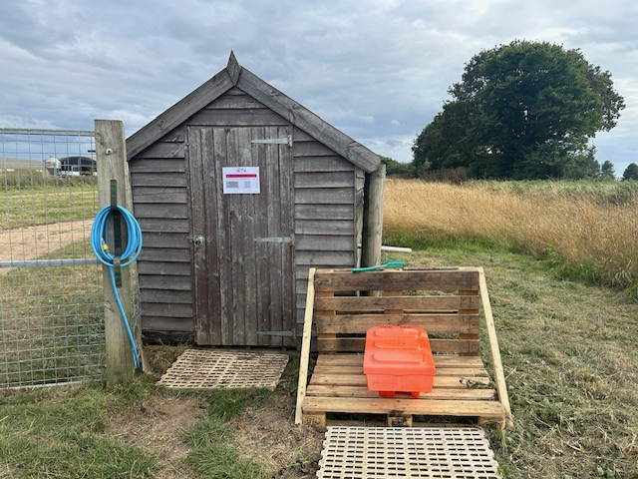
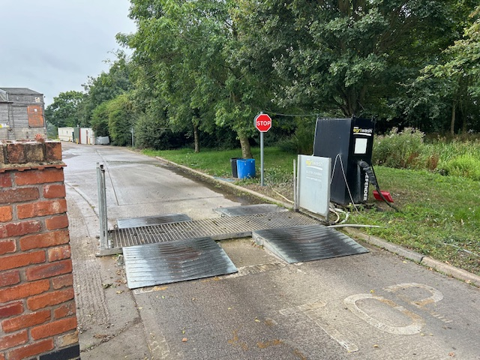
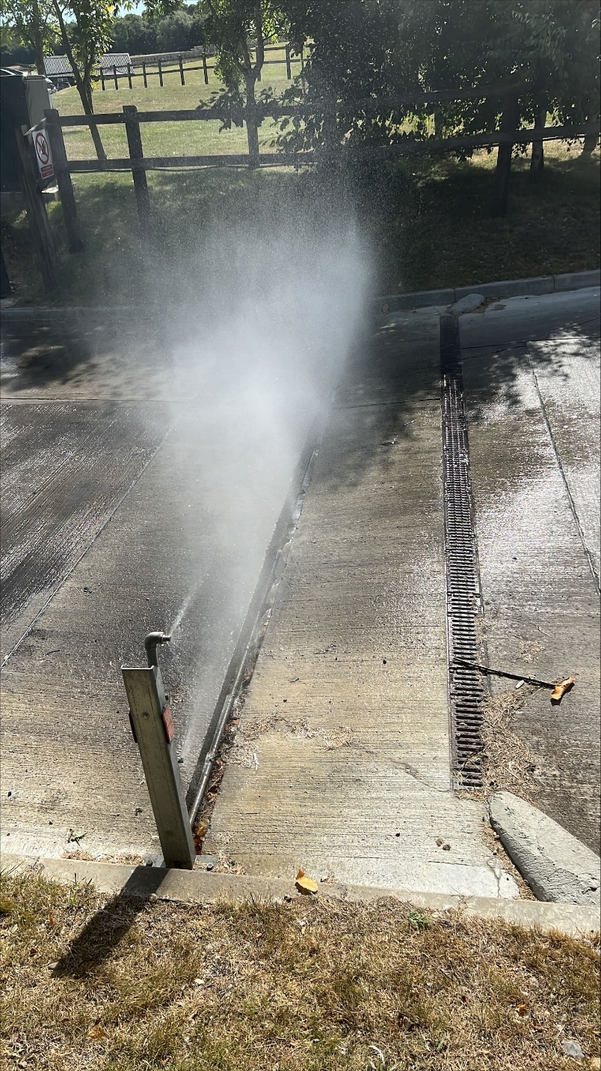
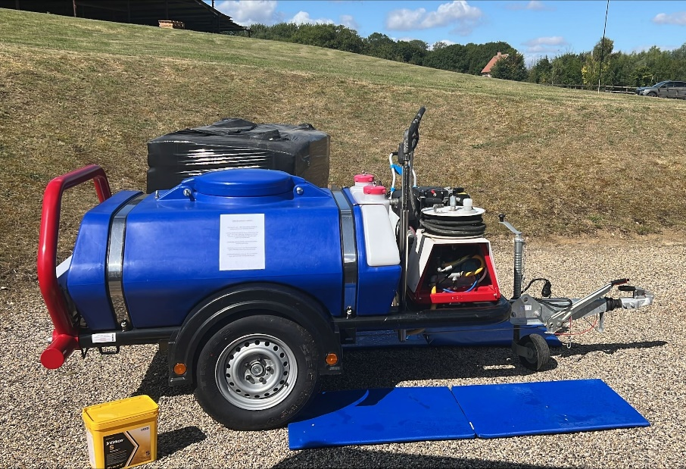
On-farm Biosecurity: The Outer Shell
Tiered system based on risk to manage “biosecurity fatigue”
Limiting access to farm areas
Multi-sites need segregation of equipment & people
  Separate entrances
  Farm vs Mill vs Egg Grader
Washing on and off site
  Under truck chassis wash
  Pressure washer used at entrance in high risk times
Feed trucks – at higher risk, reassess truck routes, increased cleaning, boot control
Increase cleaning & disinfecting when higher risk

Slide 14
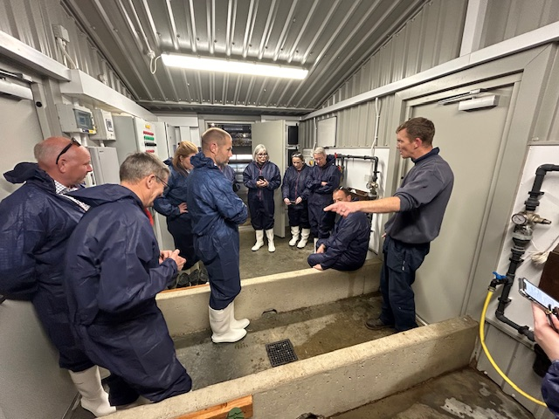
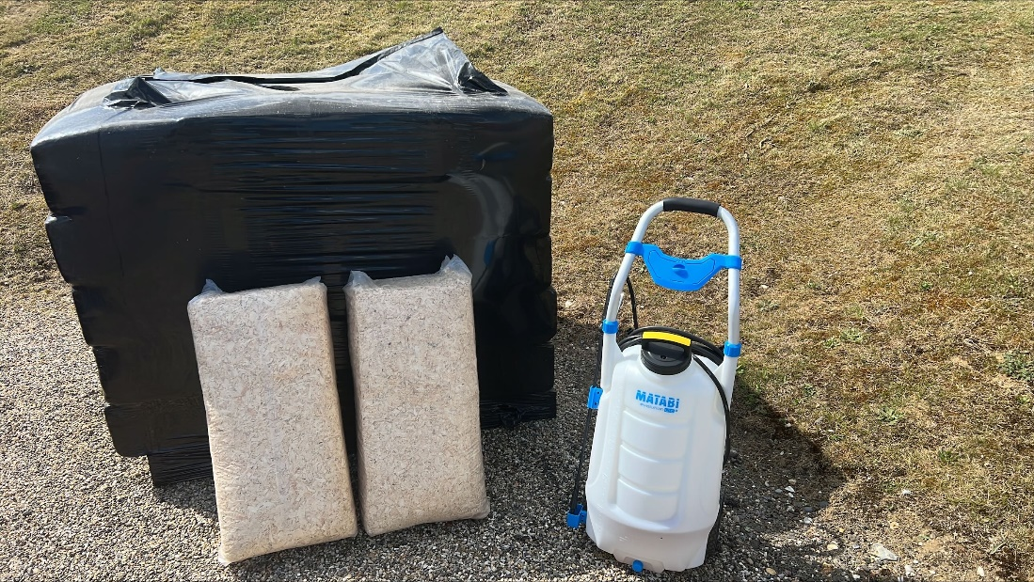
On-farm Biosecurity: The Hard Inner Shell is the Shed (High Care Zone)
Limited and Controlled access to sheds
Clear step-over for shed entrance
Footbaths outside (covered outside) and inside
Different coloured boots for outside and inside
Change overalls when higher risk
Full disinfection clean of entrance ways
Anything going into shed if fully bird proofed & cleaned
  Shavings
  Tools
Limit & control maintenance people, no tool boxes
Bird catchers & shared contractors are a specific risk to be managed
Increased washing of bird crates

Slide 15
AI - Australia
Same but different or different but the same
Australia has had 11 outbreaks since 1976
All have been H7 or H9 – No H5- why?
Wild birds Low Path – into shed – cycles – HPAI
2024 Victoria – 7/8 farms – compare Levin area
1.3 million birds Layers and ducks only
$80 Million
Costs shared by Industry and Govt

Slide 16
AI - Australia
Govt has 150 staff on outbreak
Industry 200-300 people
Depopulation- Layers gas units
          Ducks – foam in shed in small groups
Disposal – Birds -burial on initial farm
          Litter , eggs , -composting site in area
Govt and contractors depopulation
Industry – C and D

Slide 17
AI - Australia
Return to trade – 6 months optimistic
Farms in the zone not infected
Well Practiced
Equipment and people available
Labs running PCR daily
Dead bird pick in the zone up early detection system
Theory re origin and spread.
  Wind vs wheels

Slide 18
Next Steps with MPI / PIANZ / EPF
Combined approach with MPI and Industry (Broiler & Layer)
Supporting on-farm readiness
Making sure we are ready at farm level and at all levels across the sector
Workgroups to finalise operational plans in key areas
Depopulation
Disposal
Decontamination (C&D)
Movement Control / Zoning
Surveillance & Tracing
Vaccination
Continue clear communication and one source of the truth
Monthly newsletters
Monthly MPI / EPF / PIANZ governance meeting
Continued links to UK and Australia
MPI / Industry Simulation Exercise(s) to be developed and run
24 September: Sharing findings from the UK visit
25 September: Exercise in South Island
26 September: Workshop on operational plan

